Slide 1
Sampling distribution & confidence intervals

Slide 2
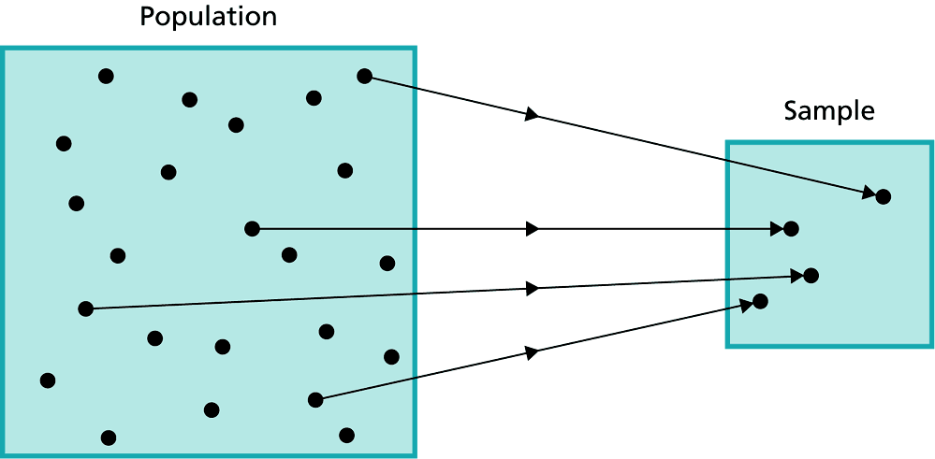
Why Sample the Population?
To contact the whole population would be time consuming.
The cost of studying all the items in a population may be prohibitive.
The physical impossibility of checking all items.
The destructive nature of certain tests.
The sample results are adequate.
抽樣
(Sampling)

Slide 3
Distributions of Population & Sampling
Population Distribution
The population distribution is the probability distribution of the population data.
Sampling Distribution
In general, the probability distribution of a sample statistic is called its sampling distribution.
The probability distribution of is called sampling distribution of sample means.

Slide 4
Distribution of Sample Means
A sampling distribution of sample means is a distribution obtained by using the means computed from random samples of a specific size taken from a population.
Sampling error is the difference between the sample measure and the corresponding population measure due to the fact that the sample is not a perfect representation of the population.

Slide 5
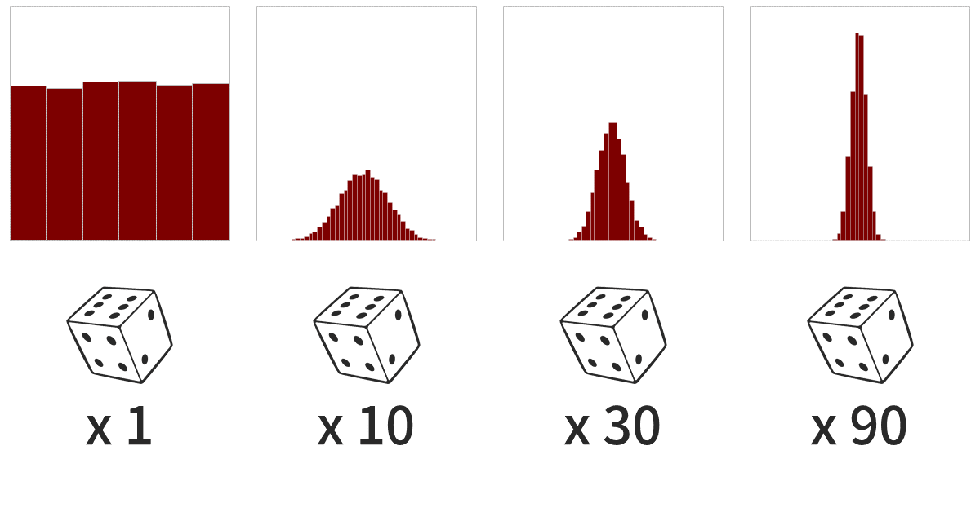

Slide 6
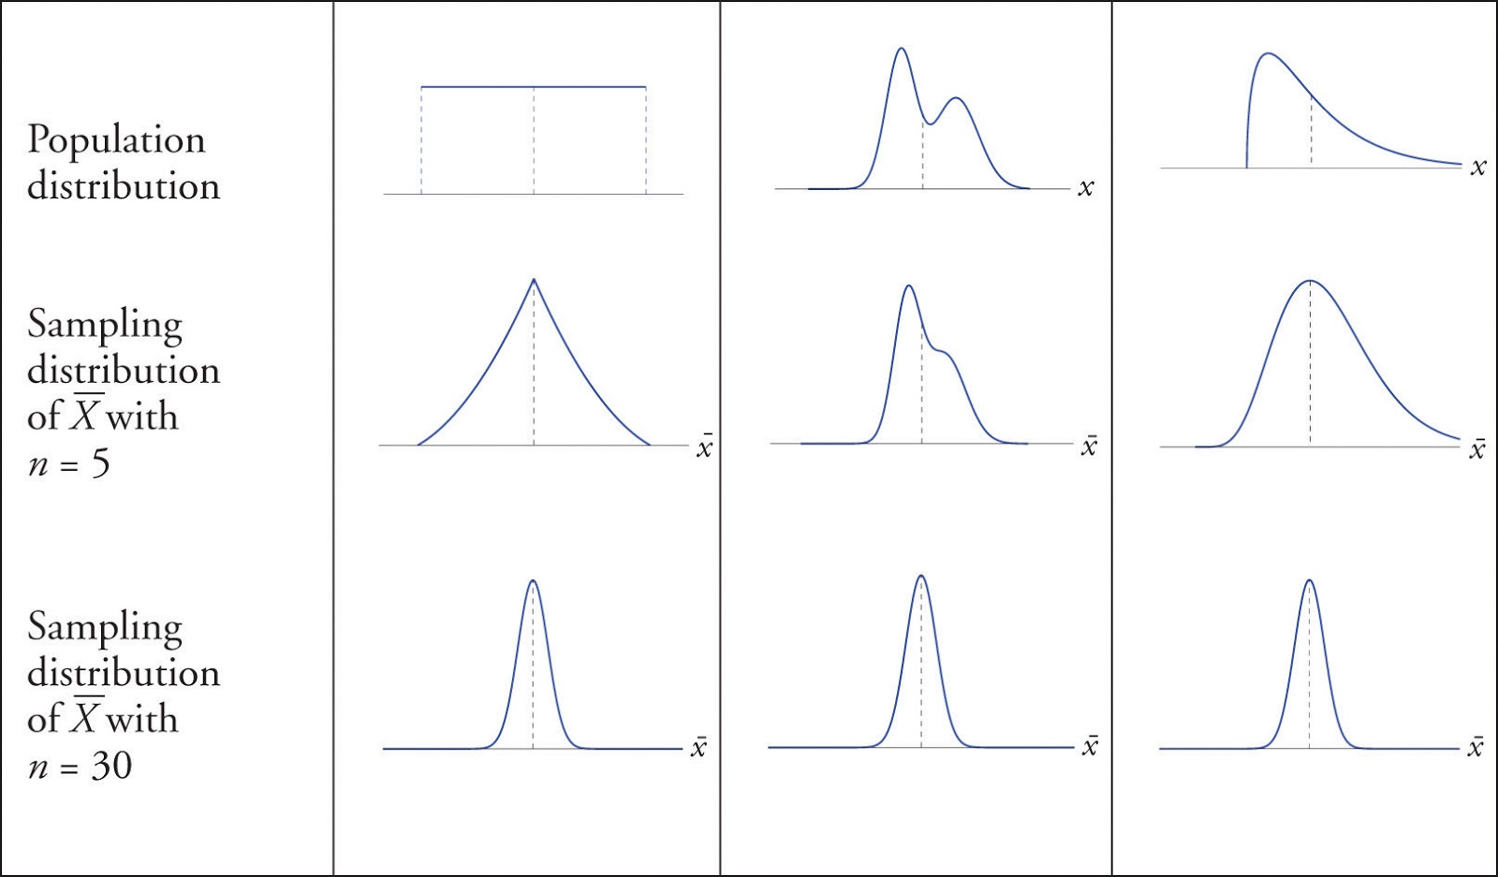

Slide 7
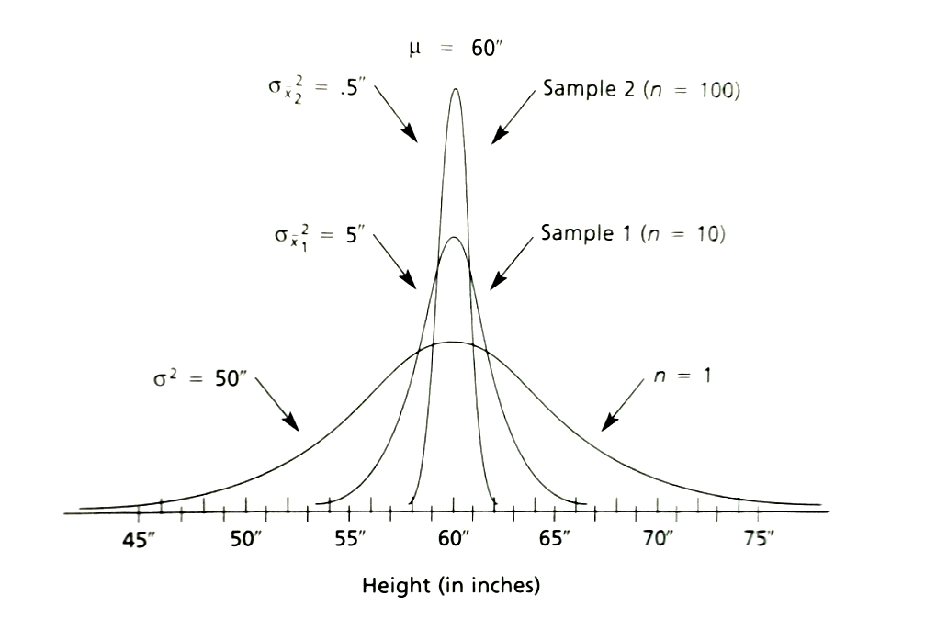

Slide 8
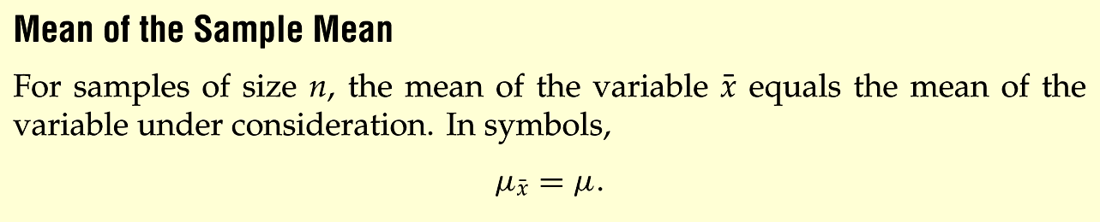
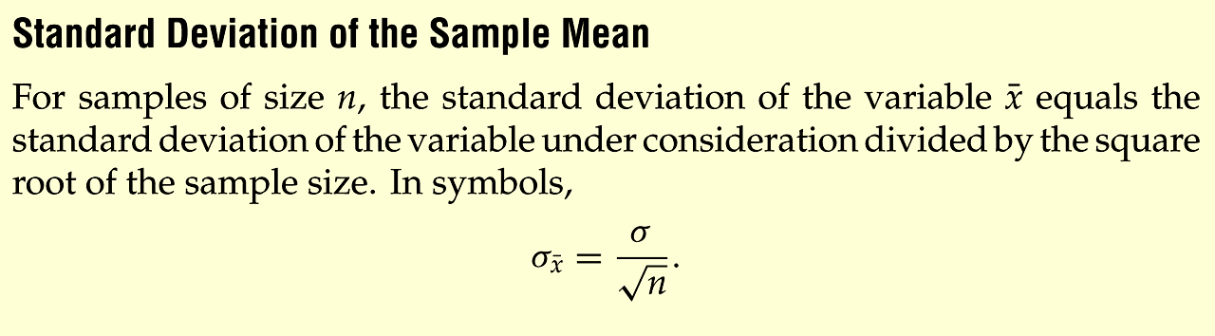
The Mean and Standard Deviation of the Sample Mean
Source: Weiss, Introductory Statistics
Notes:
Insert Formula 7.1, page 333

Slide 9
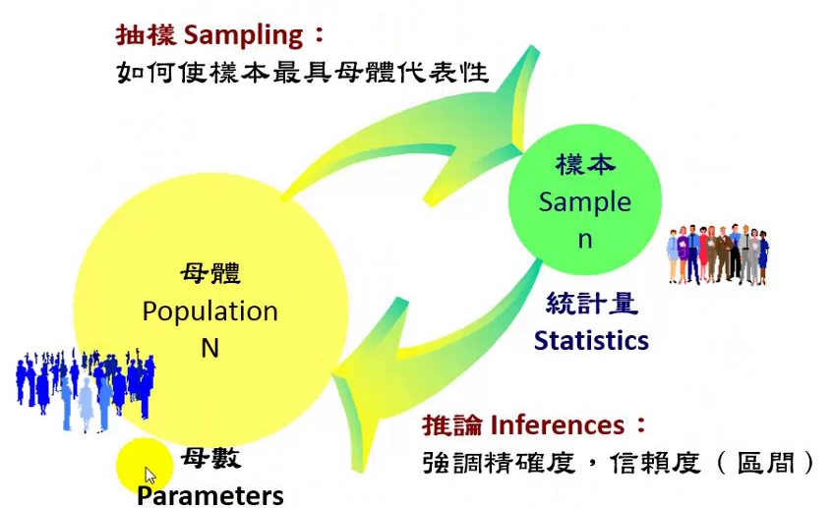

Slide 10
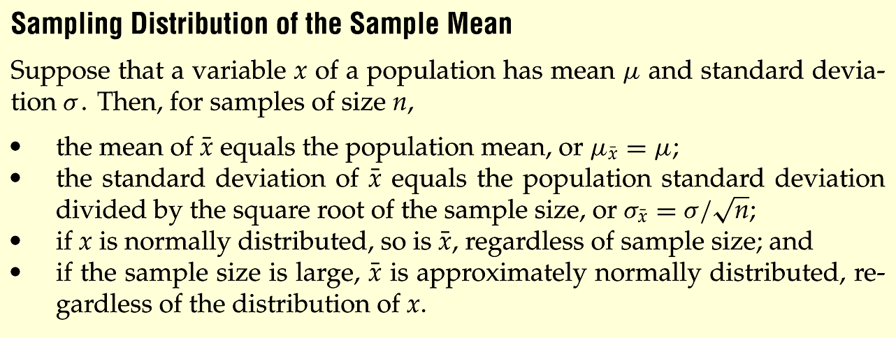
Properties of the Distribution of Sample Means
Sample size n≧30
➔ Central Limit Theorem
Notes:
Change to page 342

Slide 11
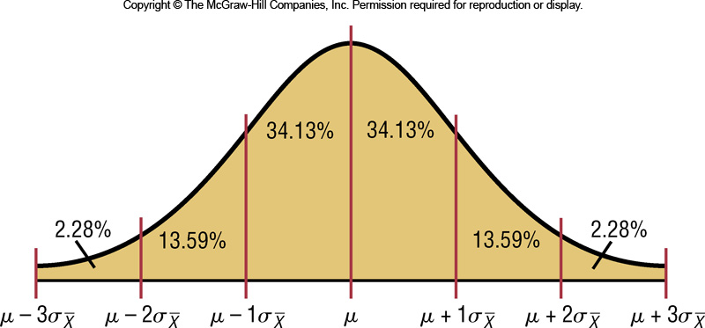
The Central Limit Theorem
A new formula must be used for the z values:

Slide 12

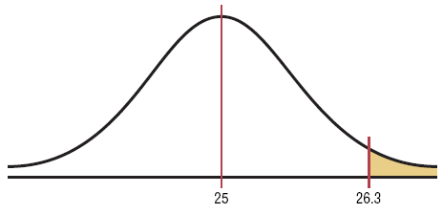
Example 6-13: Hours of watch TV
A. C. Neilsen reported that children between the ages of 2 and 5 watch an average of 25 hours of television per week. Assume the variable is normally distributed and the standard deviation is 3 hours. If 20 children between the ages of 2 and 5 are randomly selected, find the probability that the mean of the number of hours they watch television will be greater than 26.3 hours.

Slide 13
Example: Hours of watch TV
A. C. Neilsen reported that children between the ages of 2 and 5 watch an average of 25 hours of television per week. Assume the variable is normally distributed and the standard deviation is 3 hours. If 36 children between the ages of 2 and 5 are randomly selected, find the probability that the mean of the number of hours they watch television will be greater than 26.3 hours.

Slide 14
Example: Hours of Television
Since we are calculating probability for a sample mean, we need the Central Limit Theorem formula
Ans: The probability of obtaining a sample mean larger than 26.3 hours is 0.47%.

Slide 15
Example 6-13: Hours of Television
Since we are calculating probability for a sample mean, we need the Central Limit Theorem formula
Ans: The probability of obtaining a sample mean larger than 26.3 hours is 2.62%.

Slide 16
Introduction to bell-shaped distribution
Normal Distribution
t-Distribution

Slide 17
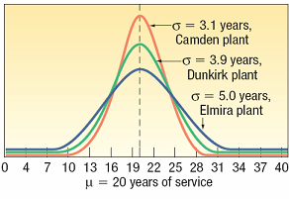
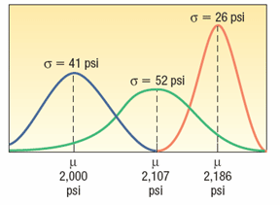
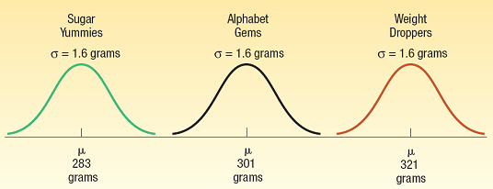
The Normal Distribution - Families

Slide 18
Normal Distributions
The mathematical equation for the normal distribution is:
→ N.D.(μ, σ²) or N.(μ, σ²)

Slide 19
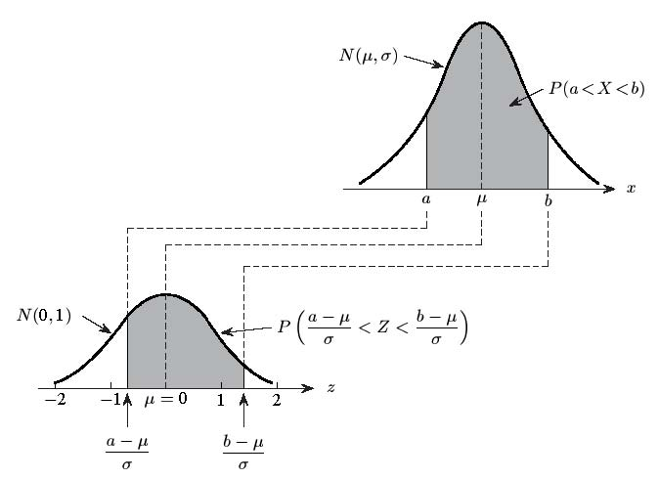
一般常態分配的標準化

Slide 20
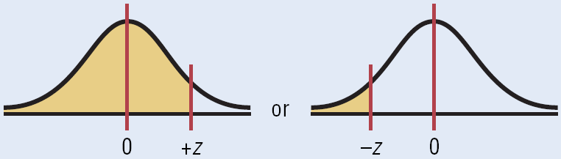
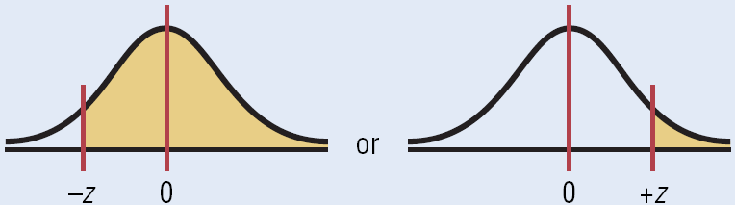
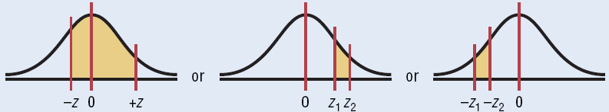
Area under the Standard Normal Distribution Curve

Slide 21
Exercise
P(-1.2<Z<2.85)=
P(0.23<Z<2.03)=
P(-2.33<Z<-0.50)=
P( |Z|<0.25)=
P(|Z|>1.50)=
P(a<Z<1.58) = 0.3442
a=
P(1.25<Z<b) = 0.0994
b=
P(-2.58<Z<b) = 0.8373

Slide 22
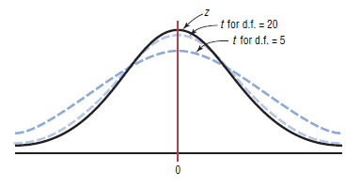
The t distribution
The t family of curves

Slide 23
Degrees of Freedom
The symbol d.f. will be used for degrees of freedom.
The degrees of freedom for a confidence interval for the mean are found by subtracting 1 from the sample size. That is, d.f. = n - 1.
Note: For some statistical tests used later in this book, the degrees of freedom are not equal to n - 1.

Slide 24
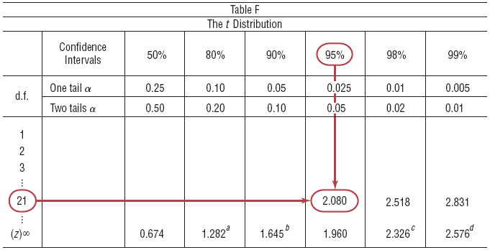
Area under the t Distribution Curve
Find the t_{α/2} value for a 95% confidence interval when the sample size is 22.
Degrees of freedom are d.f. = 21.

Slide 25
Exercise
Find the value for each
t_{α /2} and n=18 for the 99% confidence interval for the mean
t_{α /2} and n=23 for the 95% confidence interval for the mean
t_{α /2} and n=15 for the 90% confidence interval for the mean

Slide 26
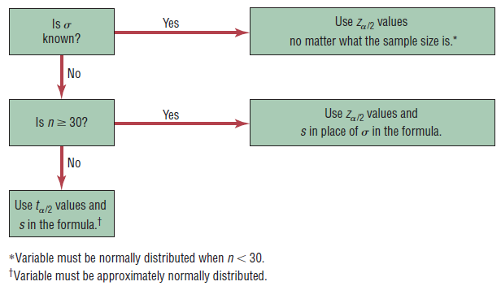
When to use the z or t distribution
Calculating the C.I. for a mean using a formula

Slide 28
Confidence Intervals for one population parameter
Mean, Proportion, Variance &
Standard Deviation
28

Slide 29
Learning Objectives
In this topic, you learn:
To construct and interpret confidence interval estimates for the mean and the proportion
How to determine the sample size necessary to develop a confidence interval estimate for the mean or proportion
How to use confidence interval estimates in auditing

Slide 30
Outline
Confidence Intervals for the Population Mean, μ
When population standard deviation σ is known
When population standard deviation σ is unknown
Confidence Intervals for the Population Proportion, p
Determining the Required Sample Size

Slide 31
Introduction
Estimate
The value(s) assigned to a population parameter based on the value of a sample statistic is called an estimate.
Estimator
The sample statistic used to estimate a population parameter is called an estimator.
Source: P.S. Mann, Introductory Statistics, 5th ed. John Wiley, 2005

Slide 32
Estimation Procedure
Parameter Statistic
μ
Select a sample.
Collect the required information from the members of the sample.
Calculate the value of the sample statistic.
Assign value(s) to the corresponding population parameter.
Source: P.S. Mann, Introductory Statistics, 5th ed. John Wiley, 2005

Slide 33
Estimation Methods
A Point Estimate
The value of a sample statistic that is used to estimate a population parameter is called a point estimate.
An Interval Estimate
In interval estimation, an interval is constructed around the point estimate, and it is stated that this interval is likely to contain the corresponding population parameter.

Slide 34
一個母體
平均數
二個母體(平均數差)
常態母體
一個母體
區間估計
變異數
二個母體(變異數比)
一個母體比例
點二項母體
二個母體比例差
江建良，統計學，普林斯頓國際有限公司

Slide 35
Topic-1
Point and Confidence Interval Estimates for a Population Mean

Slide 36
Point and Interval Estimates
A point estimate is a single number,
a confidence interval provides additional information about the variability of the estimate
Lower
Confidence
Limit
Upper
Confidence
Limit
Point Estimate
Width of
confidence interval

Slide 37
Point Estimates
We can estimate a
Population Parameter …
with a Sample Statistic
(a Point Estimate)
Mean
μ
Proportion
p

Slide 38
Confidence Intervals
How much uncertainty is associated with a point estimate of a population parameter?
An interval estimate provides more information about a population characteristic than does a point estimate.
Such interval estimates are called confidence intervals.

Slide 39

Confidence Interval Example
Population has µ = 368 and σ = 15.
Sample # | X | Lower Limit | Upper Limit | Contain µ?
1 | 362.30 | 356.42 | 368.18 | Yes
2 | 369.50 | 363.62 | 375.38 | Yes
3 | 360.00 | 354.12 | 365.88 | No
4 | 362.12 | 356.24 | 368.00 | Yes
5 | 373.88 | 368.00 | 379.76 | Yes

Slide 40
Confidence Interval Example
(continued)
In practice you only take one sample of size n
In practice you do not know µ so you do not know if the interval actually contains µ
However, you do know that 95% of the intervals formed in this manner will contain µ
Thus, based on the one sample you actually selected, you can be 95% confident your interval will contain µ (this is a 95% confidence interval)
Note: 95% confidence is based on the fact that we used Z = 1.96.

Slide 41
Estimation Process
Random Sample
I am 95% confident that μ is between 40 & 60.
Population
Mean
X = 50
(mean, μ, is unknown)
Sample
Confidence Level: Confidence of the interval will contain the unknown population parameter.

Slide 42
General Formula
The general formula for all confidence intervals is:
Point Estimate ± (Critical Value)(Standard Error)
Where:
Point Estimate is the sample statistic estimating the population parameter of interest
Critical Value is a table value based on the sampling distribution of the point estimate and the desired confidence level
Standard Error is the standard deviation of the point estimate

Slide 43
Confidence Intervals
Confidence
Intervals
Population
Mean
Population
Proportion
σ Known
σ Unknown

Slide 44
Confidence Interval for μ (σ Known)
Assumptions
Population standard deviation σ is known
Population is normally distributed
If population is not normal, use large sample
Confidence interval estimate:
where is the point estimate
Z_{α/2} is the normal distribution critical value for a probability of α/2 in each tail
is the standard error

Slide 45
Confidence Interval for μ
Consider a 95% confidence interval:
Z units:
Z_{α/2} = -1.96
0
Z_{α/2} = 1.96
X units:
Lower
Confidence
Limit
Upper
Confidence
Limit
Point Estimate
Point Estimate

Slide 46
Common Levels of Confidence
Commonly used confidence levels are 90%, 95%, and 99%
Confidence Coefficient,
Confidence Level
Z_{α/2} value
80%
90%
95%
98%
99%
99.8%
99.9%
0.80
0.90
0.95
0.98
0.99
0.998
0.999
1.28
1.645
1.96
2.33
2.58
3.08
3.27

Slide 47
Intervals and Level of Confidence
Sampling Distribution of the Mean
x
Intervals extend from
to
x₁
x₂
(1-α)x100% of intervals constructed contain μ;
(α)x100% do not.
Confidence Intervals

Slide 48
Do You Ever Truly Know σ?
Probably not!
In virtually all real world business situations, σ is not known.
If there is a situation where σ is known, then µ is also known (since to calculate σ you need to know µ.)
If you truly know µ there would be no need to gather a sample to estimate it.

Slide 49
Confidence Interval for μ (σ Unknown)
Consider a 95% confidence interval:

Slide 50
Confidence Interval for μ (σ Unknown)
Consider a 95% confidence interval:
t units:
t_{α/2}
t_{α/2}

Slide 51
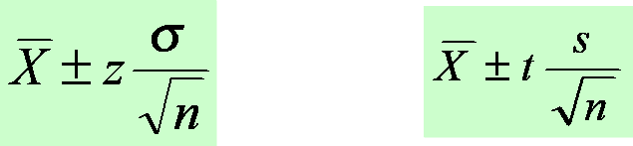
Confidence Interval Estimates for the Mean
Use Z-distribution
If the population standard deviation is known or the sample is greater than 30.
Use t-distribution
If the population standard deviation is unknown and the sample is less than 30.

Slide 52
市場調查研究-1
ABC公司每週選擇25名顧客的簡單隨機樣本，以瞭解每位顧客每次購物的花費。若以 x 表示每次購物的花費，樣本平均數可以提供母體平均數 μ 的點估計值。ABC公司進行此項調查已有數年，根據歷史資料，顧客購物花費標準差 σ = $25，也顯示母體是常態分配。試問：
樣本：平均數為100、標準差為24
欲建構母體平均數之95%信賴區間，最大抽樣誤差為何?
信賴區間之意義為何？
母體平均數 μ 之95%信賴區間為何？

Slide 53
市場調查研究-2
XYZ公司欲瞭解每位顧客每次購物的花費，因此隨機抽樣若干位顧客進行調查，若以 x 表示每次購物的花費。
試問：
若選取100名顧客為樣本
樣本：平均數為100、標準差為25
欲建構母體平均數之95%信賴區間，最大抽樣誤差為何?
μ 之95%信賴區間為何？
若選取25名顧客為樣本
樣本：平均數為80、標準差為25
欲建構母體平均數之95%信賴區間，最大抽樣誤差為何?
μ 之95%信賴區間為何？

Slide 54
課堂練習
分組練習：4~5人一組
自訂題目
上網時間、睡眠時間、手機費用、通話時間、體重、身高、慢跑3000m所需時間…(不限於此)
蒐集資料(樣本數自訂)
計算信賴區間
計算平均數、標準差
需滿足之假設條件有哪些
信賴水準
建立信賴區間

Slide 55
Topic-2
Point and Confidence Interval Estimates for a Population Proportion

Slide 56
Confidence Intervals
Confidence
Intervals
Population
Mean
Population
Proportion
σ Known
σ Unknown

Slide 57
母體比例(p)的估計與假設檢定
母體比例
統計推論
的基本概念
單一母體比例
的統計推論
(假設大樣本)
兩個母體比例差
的統計推論
(假設大樣本)
單一母體比例
的區間估計
兩母體比例差
的區間估計
單一母體比例
的假設檢定
兩母體比例差
的假設檢定
決定樣本大小

Slide 58
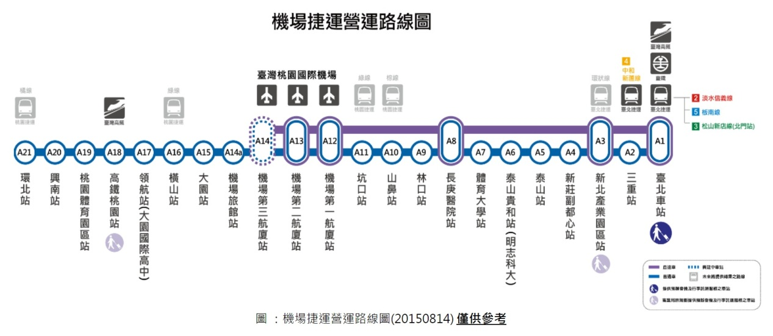

Slide 59
Confidence Intervals for Proportions
p = population proportion
(read p “hat”) = sample proportion
For a sample proportion,
where
X = number of sample units that possess the characteristics of interest, n = sample size.

Slide 60
Example: Air Conditioned Households
In a recent survey of 150 households, 54 had central air conditioning. Find and , where is the proportion of households that have central air conditioning.
Since X = 54 and n = 150,

Slide 61
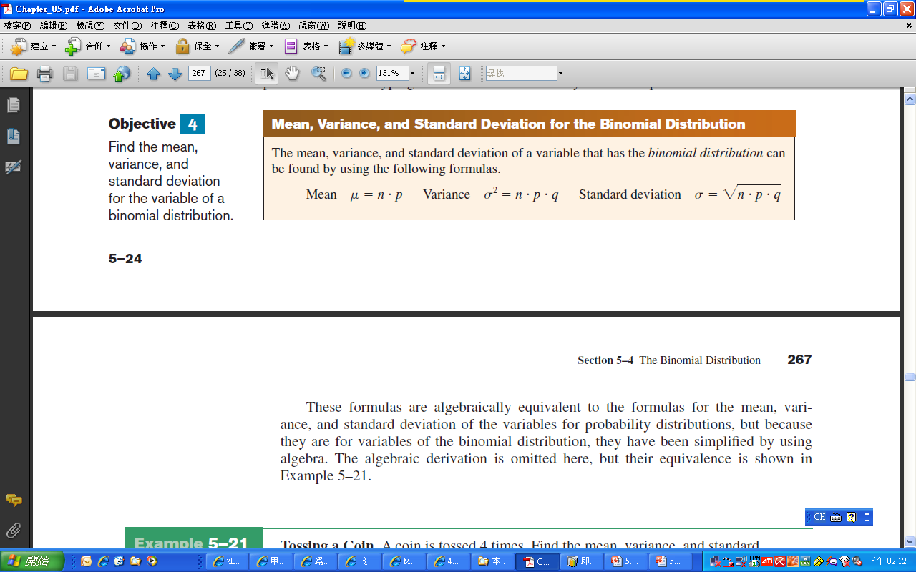
The Binomial Distribution
Bluman, Chapter 5

Slide 62

Example: Likelihood of Twins
The Statistical Bulletin published by Metropolitan Life Insurance Co. reported that 2% of all American births result in twins. If a random sample of 8000 births is taken, find the mean, variance, and standard deviation of the number of births that would result in twins.

Slide 63
Recall that the distribution of the sample proportion is approximately normal if the sample size is large, with standard deviation
We will estimate this with sample data

Slide 64
Formula for a Specific Confidence Interval for a Proportion
when np ≥ 5 and nq ≥ 5.
Rounding Rule: Round off to three decimal places.

Slide 65

Example: Male Nurses
A sample of 500 nursing applications included 60 from men. Find the 90% confidence interval of the true proportion of men who applied to the nursing program.

Slide 66
Example: Male Nurses
A sample of 500 nursing applications included 60 from men. Find the 90% confidence interval of the true proportion of men who applied to the nursing program.
You can be 90% confident that the percentage of applicants who are men is between 9.6% and 14.4%.

Slide 67

Example: Religious Books
A survey of 1721 people found that 15.9% of individuals purchase religious books at a Christian bookstore. Find the 95% confidence interval of the true proportion of people who purchase their religious books at a Christian bookstore.
看臉書算閱讀？ 調查：近半國人不看書

Slide 68
Example: Religious Books
A survey of 1721 people found that 15.9% of individuals purchase religious books at a Christian bookstore. Find the 95% confidence interval of the true proportion of people who purchase their religious books at a Christian bookstore.
You can say with 95% confidence that the true percentage is between 14.2% and 17.6%.

Slide 69

Example
A random sample of 100 people shows that 25 are left-handed.
Form a 95% confidence interval for the true proportion of left-handers

Slide 70
Example
(continued)
A random sample of 100 people shows that 25 are left-handed. Form a 95% confidence interval for the true proportion of left-handers.
np = 100*0.25 = 25 > 5 & n(1-p) = 100*0.75 = 75 > 5
Make sure
the sample
is big enough

Slide 71
Interpretation
We are 95% confident that the true percentage of left-handers in the population is between
16.51% and 33.49%.
Although the interval from 0.1651 to 0.3349 may or may not contain the true proportion, 95% of intervals formed from samples of size 100 in this manner will contain the true proportion.

Slide 72
Determining Sample Size
Determining
Sample Size
For the
Mean
For the
Proportion

Slide 73
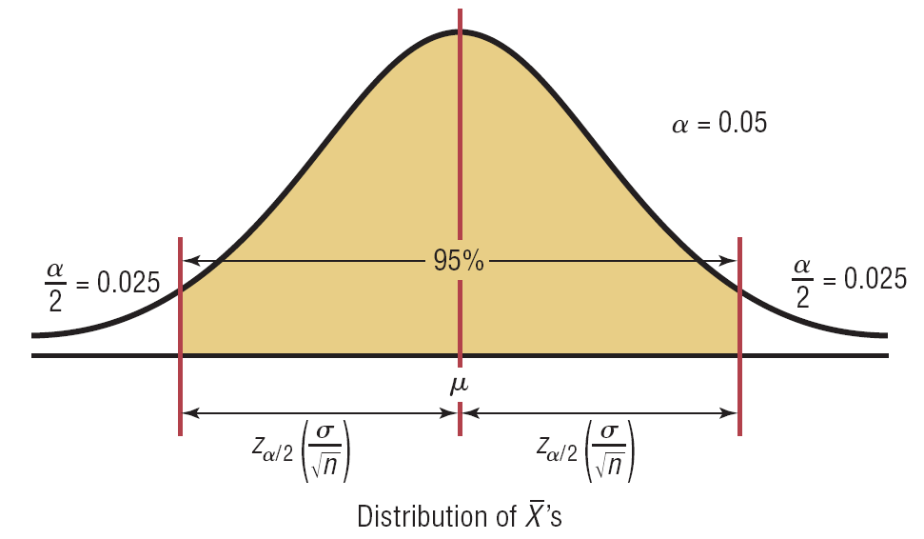
Sampling Error
The required sample size can be found to obtain a desired margin of error (e) with a specified level of confidence (1 - α)
The margin of error is also called sampling error
the amount of imprecision in the estimate of the population parameter
the amount added and subtracted to the point estimate to form the confidence interval

Slide 74
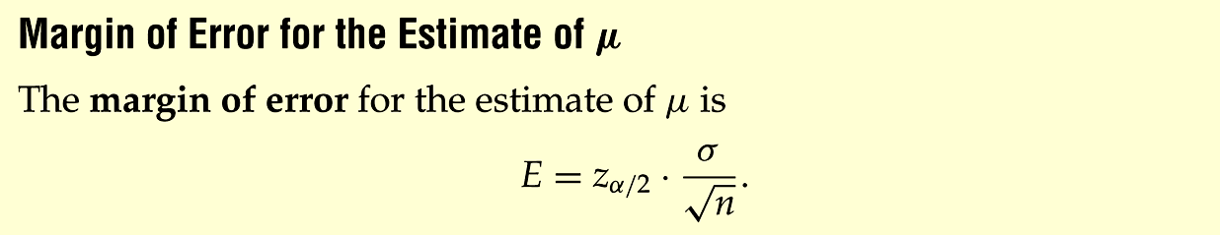
Margin of Error for the estimate
-Z_{α/2}
Z_{α/2}
Source: Bluman, Chapter 7
(Maximum Error of the Estimate)

Slide 75
Determining Sample Size
Determining
Sample Size
For the
Mean

Slide 76
Determining Sample Size
(continued)
To determine the required sample size for the mean, you must know:
The desired level of confidence (1 - α), which determines the critical value, Z_{α/2}
The acceptable sampling error, e
The standard deviation, σ

Slide 77
Required Sample Size Example
If σ = 45, what sample size is needed to estimate the mean within ± 5 with 90% confidence?
So the required sample size is n = 220
(Always round up)

Slide 78
Determining Sample Size
(continued)
Determining
Sample Size
For the
Proportion
Now solve for n to get

Slide 79
Determining Sample Size
(continued)
To determine the required sample size for the proportion, you must know:
The desired level of confidence (1 - α), which determines the critical value, Z_{α/2}
The acceptable sampling error, e
The true proportion of events of interest, p
p can be estimated with a pilot sample if necessary (or conservatively use 0.5 as an estimate of p)

Slide 80
Required Sample Size Example
How large a sample would be necessary to estimate the true proportion defective in a large population within ±3%, with 95% confidence?
(Assume a pilot sample yields = 0.12)

Slide 81
Required Sample Size Example
(continued)
Solution:
For 95% confidence, use Z_{α/2} = 1.96
e = 0.03
= 0.12, so use this to estimate p
So use n = 451

Slide 82
Example: Home Computers
A researcher wishes to estimate, with 95% confidence, the proportion of people who own a home computer. A previous study shows that 40% of those interviewed had a computer at home. The researcher wishes to be accurate within 2% of the true proportion. Find the minimum sample size necessary.
The researcher should interview a sample of at least 2305 people.

Slide 83
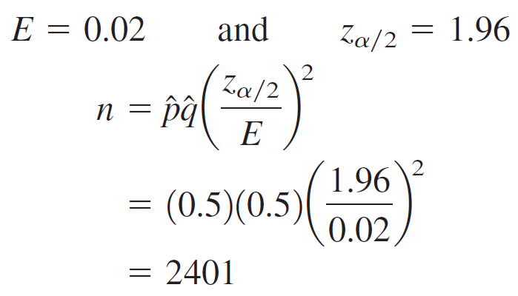
Example: Home Computers
In last example assume that no pervious study was done. Find the minimum sample size necessary to be accurate within 2% of the true population.
Here = 0.5 and = 0.5.
2401 people must be interviewed when is unknown. This is 96 more people needed if is known

Slide 84
Exercises
Exercises 7-3 (p.395)
#5, 8, 13, 14, 15, 18

Slide 85
Topic-3
Point and Confidence Intervals for Variances and Standard Deviations

Slide 86



Introduction

Slide 87
Confidence Intervals for σ² & σ
When products that fit together (such as pipes) are manufactured, it is important to keep the variations of the diameters of the products as small as possible; otherwise, they will not fit together properly and will have to be scrapped.
In the manufacture of medicines, the variance and standard deviation of the medication in the pills play an important role in making sure patients receive the proper dosage.
For these reasons, confidence intervals for variances and standard deviations are necessary.

Slide 88
Chi-Square Distributions
The chi-square distribution must be used to calculate confidence intervals for one population variance and standard deviation.
The chi-square variable is similar to the t variable in that its distribution is a family of curves based on the number of degrees of freedom.
The symbol for chi-square is (Greek letter chi, pronounced “ki”).
A chi-square variable cannot be negative, and the distributions are skewed to the right.
Bluman Chapter 7

Slide 89
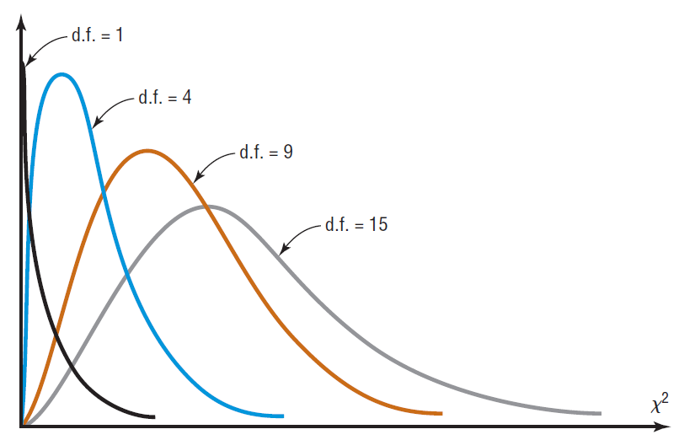
Chi-Square Distributions
At about 100 degrees of freedom, the chi-square distribution becomes somewhat symmetric.
The area under each chi-square distribution is equal to 1.00, or 100%.
Bluman Chapter 7

Slide 90
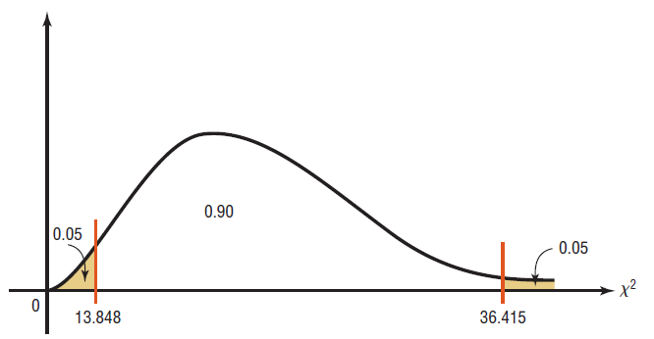
Example 7-13: Using Table G
Find the values for and for a 90% confidence interval when n = 25.
To find , subtract 1 – 0.90 = 0.10. Divide by 2 to get 0.05.
To find , subtract 1 – 0.05 to get 0.95.

Slide 91
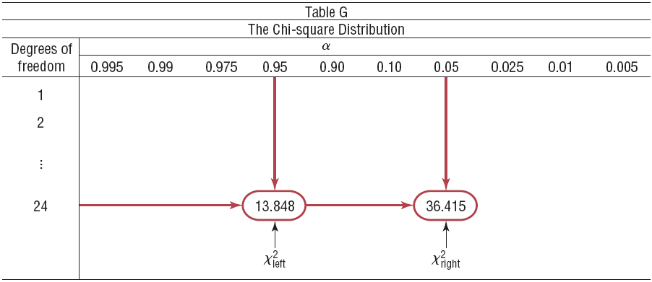
Example 7-13: Using Table G
Use the 0.95 and 0.05 columns and the row corresponding to 24 d.f. in Table G.

Slide 92
Formula for the C.I. for a Variance
For a Variance
For a Standard Deviation

Slide 93
Confidence Intervals for σ² & σ
Rounding Rule
When you are computing a confidence interval for a population variance or standard deviation by using raw data, round off to one more decimal places than the number of decimal places in the original data.
When you are computing a confidence interval for a population variance or standard deviation by using a sample variance or standard deviation, round off to the same number of decimal places as given for the sample variance or standard deviation.

Slide 94
Assumptions
Assumptions for finding a CI for a variance or std.
The sample is randomly selected.
The population must be normally distributed.

Slide 95

Example 7-14: Osteoporosis
A study of 30 women found the standard deviation of their ages was 5.2 years. Find the 95% confidence interval for the variance and standard deviation for the age variable. Assume the variable is normally distributed.

Slide 96
Example 7-14: Osteoporosis
Find the 95% confidence interval for the variance and standard deviation for the age variable, if a sample of 30 women has a standard deviation of 5.2 years.
Solution:
To find , (1 – 0.95) / 2 = 0.025.
To find , (1 – 0.025) = 0.975.
➔

Slide 97
Example 7-14:
You can be 95% confident that the true variance for the women with osteoporosis is between 17.2 and 48.9 years.
You can be 95% confident that the true standard deviation is between 4.1 and 7.0 years.

Slide 98



Example: Cost of Ski Lift Tickets
Find the 90% confidence interval for the variance and standard deviation for the number of named storms per year in the Atlantic basin. A random sample of 10 years has been used. Assume the distribution is approximately normal.
10 5 12 11 13
15 19 18 14 16

Slide 99
Example: Cost of Ski Lift Tickets
Find the 90% confidence interval for the variance and standard deviation for the number of named storms per year in the Atlantic basin. A random sample of 10 years has been used. Assume the distribution is approximately normal. 10 5 12 11 13
15 19 18 14 16
Solution:
We find the variance of the data is s² = 16.9.
In Table G, the 0.05 and 0.95 columns with the d.f. 9 row yield a value of 16.919 and 3.325, respectively.

Slide 100
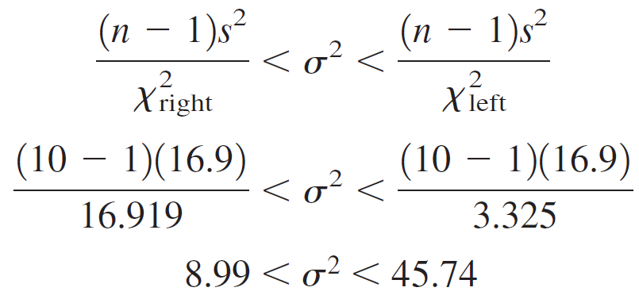
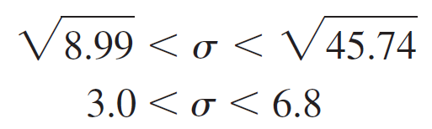
Example : Cost of Ski Lift Tickets
You can be 90% confident that the true variance for the cost of ski lift tickets is between 9.0 and 45.74 (rounding rule).
You can be 95% confident that the standard deviation is between 3.0 and 6.8 for named storms in a sample 10 years.

Slide 101
Exercises
Exercises 7-4 (p403)
#1-5, 11, 15

